Slide 1
The 8 Puzzle
Anushka Chinoy
Kiara Vasquez
Medhi Welsh-Brito

Slide 2
Table of Contents
01
02
03
04
Introduction
Description of the 8-puzzle and how to solve it.
Implementation
Algorithms used to solve the 8-puzzle and how they work.
Results & Demo
Outcomes and a demo of the code in work.
Discussion
Analysis of results and concluding thoughts.

Slide 3
01
Introduction
Description of the 8-puzzle
and how to solve it.

Slide 4
8-puzzle
1
4
6
1
2
3
7
3
8
4
5
8
2
7
6
5
Setup: 3x3 puzzle of 9 tiles—1 empty tile + 8 numbered 1-8
Initial state: empty tile in center, random arrangement of others
Goal state: empty tile in center, 1-8 clockwise around edges
Moves: swap/slide empty tile with a numbered tile
Order of moves: left, up, right, down
What about initial states that are impossible to solve?
Notes:
The 8-puzzle is a 3x3 puzzle involving 9 tiles: eight are numbered 1-8 and one is an empty tile. The goal is to arrange each tile such that the 1-8 tiles go in order around the edge of the matrix starting at the top left corner. To move the puzzle from the initial state to the goal state, tiles must be swapped one at a time with the empty tile to move them around

Slide 5
Can the puzzle be solved?
Inversions occur when a tile has a greater value than a tile appearing after it along the edges.
The goal state has an even number of inversions.
Initial state has odd # of inversions:
→ swap changes # of inversions by an odd number
→ cannot reach goal
Initial state has even # of inversions:
→ swap changes # of inversions by an even number
→ can reach goal
Inversions
Even
Odd
Solvable
Unsolvable

Slide 6
Solvable vs. Unsolvable
1
3
4
3
5
1
8
6
2
4
7
5
2
8
7
6
Solvable
Unsolvable
(3 , 2) , (4, 2),
(6, 2) , (6, 5)
= 4 (even)
(3, 1) , (3, 2) , (5, 1) ,
(5, 4) , (5, 2) , (4, 2) ,
(6, 2) , (7, 2) , (8, 2)
= 9 (odd)

Slide 7
02
Implementation
Algorithms used to solve the 8-puzzle and how they work.
Notes:
The project was implemented in Python split into three files: a text file with the initial state, a dependent file with the algorithms implementation and a main file to execute the program.

Slide 8
main.py
Input file with initial
state is read
initial_state.txt
Call each of BFS, DFS, and Dijkstra on initial state
algorithms.py
Step 1
Step 2
Step 3
Step 4
Continue if solvable
and exit if not
solvable()
Path and cost of
each are printed

Slide 9
BFS
algorithms.py
Description:
Breadth-first search (BFS)
Traverses by width
Queue (fifo) structure
fifo = first-in, first-out
No edge weights (cost = 1)
Pseudocode:
Initialize queue
Add initial state to queue
Initialize discovered set
While queue isn’t empty
Get “oldest” state & dequeue it
If goal state then return
Mark state as discovered
Get each child state by swapping (L, U, R, D order)
Calculate cost of child state
If not discovered
Enqueue child
a
b
c
d
e
f
g
Graph traversal is in alphabetical order.

Slide 10
DFS
algorithms.py
Description:
Depth-first search (DFS)
Traverses by depth
Stack (lifo) structure
lifo = last-in, first-out
No edge weights (cost = 1)
Pseudocode:
Initialize stack (list)
Add initial state to stack
Initialize discovered set
Mark initial state as discovered
While stack isn’t empty
Get “newest” state & pop it
If goal state then return
Get each child state by swapping (D, R, U, L order)
Calculate cost of child state
If not discovered
Push child
Mark child as discovered
If goal state then return
a
b
e
c
d
f
g
Graph traversal is in alphabetical order.

Slide 11
Dijkstra
algorithms.py
Description:
Traverses by minimum path
Priority queue (min-heap)
Min-out, maintain heap
Edge weights = value of tile
Pseudocode:
Initialize priority queue
Add initial state to queue
Initialize discovered set
Mark initial state as discovered
While queue isn’t empty
Get min-cost state & pop it, maintain heap
If goal state then return
Get each child state by swapping (L, U, R, D order)
Calculate cost of child state
If not discovered
Push child, maintain heap
Mark child as discovered
0
a
1
7
b
e
6
4
11
9
d
c
g
f
Graph traversal is in alphabetical order.

Slide 12
03
Results & Demo
Outcomes and a demo of
the code in work.

Slide 13
Demo
Now for a demonstration of the code using the initial state shown.
The resulting costs should be 4, 28, and 11 for each of BFS, DFS, and Dijkstra’s.
Other examples can be demonstrated by altering the “initial_state.txt” file.
1
3
4
8
2
7
6
5

Slide 14
BFS vs DFS vs Dijkstra Cost
Initial State | BFS | DFS | Dijkstra
{1, 3, 4, 8, 0, 2, 7, 6, 5} | 4 | 28 | 11
{1, 3, 4, 8, 0, 6, 7, 5, 2} | 8 | 52634 | 30
{1, 4, 8, 3, 0, 6, 7, 5, 2} | 18 | 2798 | 70

Slide 15
04
Discussion
Analysis of the results and
concluding thoughts.

Slide 16
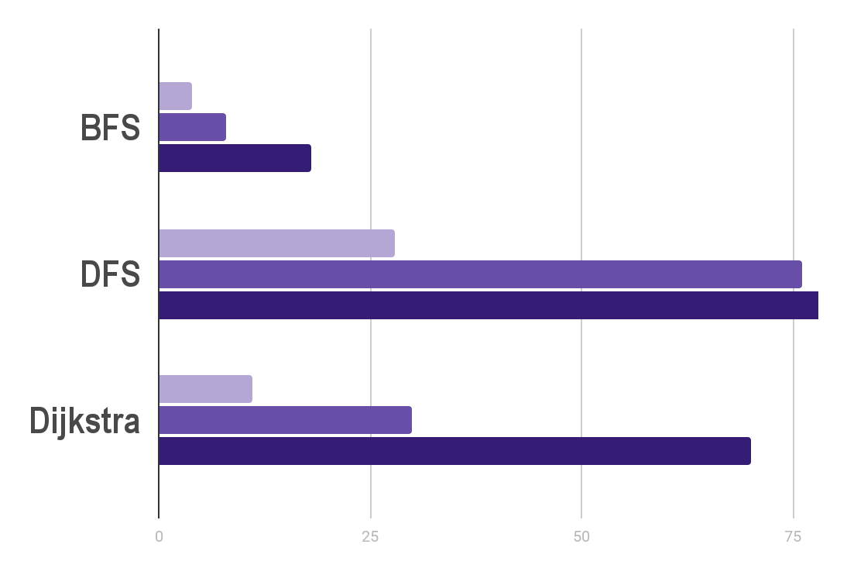
Performance Measures
Interesting Finds
Cost
52K
DFS cost, initial state 2
Order: left, up, right, down
…
…
14K
45K
DFS cost, initial state 2
Order: up, down, left, right
Initial State 1
Initial State 2
Initial State 3

Slide 17
Analysis
BFS
Gets optimal solution
Fast & low cost
DFS
Doesn’t get optimal solution
Slow & high cost
Dijkstra
Gets optimal solution
Fast & low cost

Slide 18
References
T. Brown, “Solving 8 Puzzle: Exploring Search Options - JavaScript in Plain English,” Medium, Jan. 07, 2022. [Online]. Available: https://javascript.plainenglish.io/solving-8-puzzle-exploring-search-options-2e446e29d21

